Slide 1
MODULE 6: Information Security and Risk Management
-by
Dr. Shalu Chopra
Department of Information Technology
VESIT

Slide 2
What are Security Policies?
A security policy is a document that states in writing how a company plans to protect its physical and information technology (IT) assets.
Security policies are living documents that are continuously updated and modified as technologies, vulnerabilities and security requirements change.

Slide 3
Why are security policies important?
Security policies are important because they protect an organizations' assets, both physical and digital. They identify all company assets and all threats to those assets.
Physical security policies are aimed at protecting a company's physical assets, such as buildings and equipment, including computers and other IT equipment.
Data security policies protect intellectual property from costly events, like data breaches and data leaks.

Slide 4
Characteristics of Policies
Driven by organization's Mission and objectives
Clearly expressed and unambiguous
Adhere to local and global laws and regulations
Future looking
Clearly define Role and responsibilities
Version controlled and protected from unauthorized modification
Periodically reviewed, audited and checked for compliance or non-compliance
Repeatedly communicated to all stakeholders

Slide 5
Types of security policies
Security policy types are divided into three types based on the scope and purpose of the policy:
Organizational. These policies are a master blueprint of the entire organization's security program.
System-specific. A system-specific policy covers security procedures for an information system or network.
Issue-specific. These policies target certain aspects of the larger organizational policy.

Slide 6
Types of Policy
Organizational/ Program Policy
Issue-Specific/ Functional policy
System-Specific Policy
These policies form a hierarchy where Program policy is at the top, highest-level and strategically defined. This is also called organization policy
Issue-specific policies deal with a specific issues like email privacy, employee authorization, leaving/terminating. They are called functional Policy also.
System specific is the most granular form that provides information and direction for particular systems. They cover specific or individual computer systems like firewalls and web servers.

Slide 7
Some examples of policies:
Virus and Spyware Protection policy
It helps to detect, removes, and repairs the side effects of viruses and security risks by using signatures.
It helps to detect the threats in the files which the users try to download by using reputation data from Download Insight.
It helps to detect the applications that exhibit suspicious behavior by using SONAR heuristics and reputation data.
LiveUpdate policy
This policy can be categorized into two types one is LiveUpdate Content policy, and another is LiveUpdate Setting Policy.
The LiveUpdate policy contains the setting which determines when and how client computers download the content updates from LiveUpdate. We can define the computer that clients contact to check for updates and schedule when and how often clients computer check for updates.

Slide 8
Some examples of policies:
Firewall Policy
This policy blocks the unauthorized users from accessing the systems and networks that connect to the Internet.
It detects the attacks by cybercriminals.
It removes the unwanted sources of network traffic.
Intrusion Prevention policy
This policy automatically detects and blocks the network attacks and browser attacks. It also protects applications from vulnerabilities. It checks the contents of one or more data packages and detects malware which is coming through legal ways.

Slide 9
Some examples of policies:
Application and Device Control
This policy protects a system's resources from applications and manages the peripheral devices that can attach to a system. The device control policy applies to both Windows and Mac computers whereas application control policy can be applied only to Windows clients.
Host Integrity policy
This policy provides the ability to define, enforce, and restore the security of client computers to keep enterprise networks and data secure. We use this policy to ensure that the client's computers who access our network are protected and compliant with companies?
For eg. this policy requires that the client system must have installed antivirus.

Slide 10
TYPES OF SECURITY POLICIES
Three most popular categories from admin :
Advisory Policy: Advisory policy strongly advises employees on the behaviors and activities which should and should not take place within the organization.
Regulatory Policy: Regulatory policy ensures that the organization is following standards set by specific industry regulations. These policies are security policies that an organization must implement due to compliance, regulation, or other legal requirements.
Informative Policy: The purpose of which is to communicate information to a specific audience. Informative policies typically carry less importance than regulatory or advisory policies

Slide 11
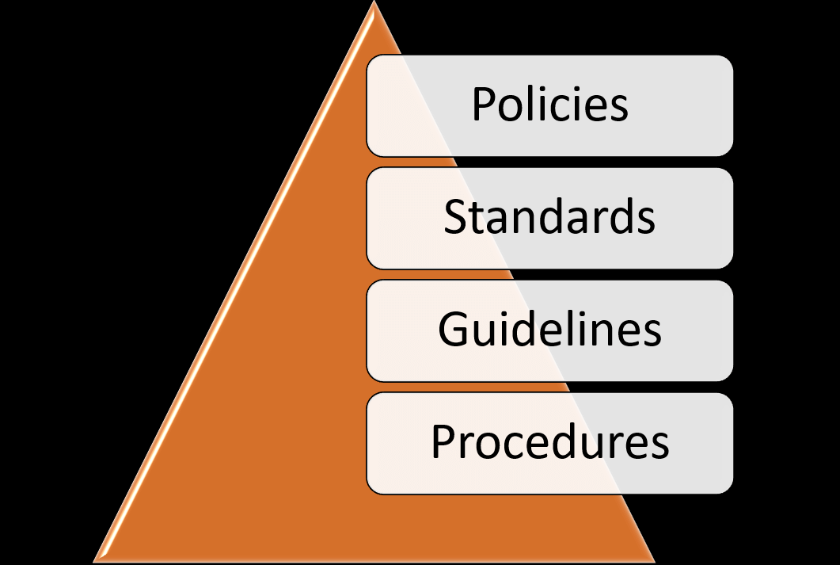

Slide 12
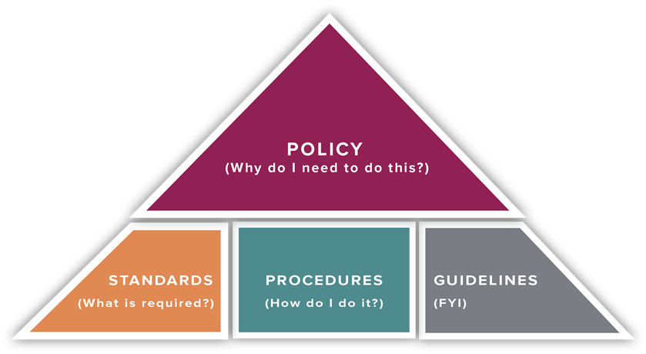
Policies, Standards, Guidelines and Procedures

Slide 13

Policies, Standards, Guidelines and Procedures
GUIDELINES
General statements, recommendations, or administrative instructions designed to achieve the policy’s objectives by providing a framework to implement procedures.
Can change frequently based on the environment and should be reviewed more frequently than standards and policies.
Is not mandatory, but rather is a suggestion of a best practice.

Slide 14

Policies, Standards, Guidelines and Procedures
PROCEDURES
Procedures are the operational processes necessary to implement institutional policy and describe the process: who does what, when they do it, and under what criteria.
Procedures may integrate:
A series of steps taken to accomplish an end goal.
Define “how” to protect resources.
Specify the structure to enforce the policy and provide a quick reference in times of crisis

Slide 15
Policies, Standards, Guidelines and Procedures
STANDARDS
A mandatory action or rule designed to support and conform to a policy.
A standard should make a policy more meaningful and effective.
Must include one or more accepted specifications, typically developed in accordance with published federal, state or industry regulations, requirements or standards.

Slide 16
Policies, Standards, Guidelines and Procedures
POLICY
A formal, high-level statement with broad application throughout the Organisation / Institute designed to promote operational efficiencies, enhance the Organisation's mission, or reduce institutional risk.
Policies state required actions, and may include linkages to standards or procedures.
Policy attributes include the following:
Require compliance (mandatory)
Failure to comply results in disciplinary action
Focus on desired results, not on means of implementation
Further defined by standards, procedures and guidelines

Slide 18
Risk Analysis

Slide 19
RISK ANALYSIS
Risk is made up of two parts: the probability of something going wrong, and the negative consequences if it does.
Risk Analysis is a process that helps you identify and manage potential problems that could undermine key business initiatives or projects.
To carry out a Risk Analysis, you must first identify the possible threats that you face, and then estimate the likelihood that these threats will materialize.

Slide 20
DETAILED RISK ANALYSIS
The detailed process of risk analysis is as follows:
Identity Assets
Determine Vulnerabilities
Analyse Risks
Analyse Existing security controls
Estimate likelihood of Exploitation- Rare, Unlikely, Possible, Likely, Almost Certain
Determine Impact of Risk- Insignificant, Minor, Moderate, Major, Catastrophic, Doomsday.

Slide 21
DETAILED RISK ANALYSIS
Determine Level of Risk: Extreme, High, Medium, Low.
Compute Expected Annual Loss
Document the Results
Evaluate Risks
Risk Treatment
Survey applicable controls and their costs
Project costs and savings

Slide 22
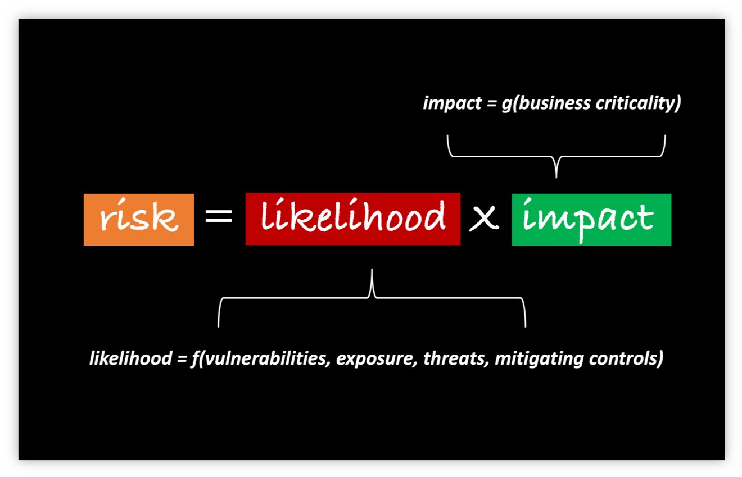

Slide 23
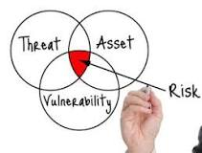
Threat, risk and vulnerability
A vulnerability is a flaw or weakness in an asset’s design, implementation, or operation and management that could be exploited by a threat.
A threat is a potential for a threat agent to exploit a vulnerability.
A risk is the potential for loss when the threat happens.

Slide 24
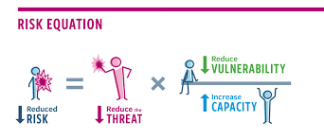
Threat, risk and vulnerability

Slide 25
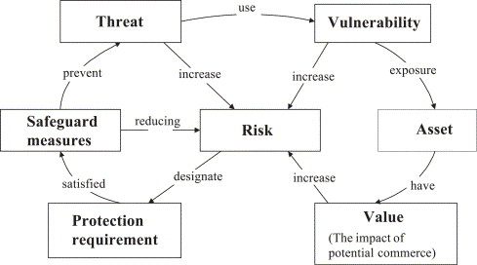

Slide 26
APPROACHES TO RISK ANALYSIS
Baseline Approach
The baseline approach to risk assessment aims to implement a basic general level of security controls on systems using baseline documents, codes of practice, and industry best practice.
The advantages of this approach are that it does not require the expenditure of additional resources in conducting a more formal risk assessment and that the same measures can be replicated over a range of systems.
The major disadvantage is that no special consideration is given to variations in the organization’s risk exposure based on who they are and how their systems are used.

Slide 27
APPROACHES TO RISK ANALYSIS
Informal Approach
The informal approach involves conducting some form of informal, pragmatic risk analysis for the organization’s IT systems.
This analysis does not involve the use of a formal, structured process, but rather exploits the knowledge and expertise of the individuals performing this analysis.
The major disadvantage is because a formal process is not used, there is a chance that some risks may not be considered appropriately, potentially leaving the organization vulnerable.

Slide 28
APPROACHES TO RISK ANALYSIS
Detailed Risk Approach
The third and most comprehensive approach is to conduct a detailed risk assessment of the organization’s IT systems, using a formal structured process.
This provides the greatest degree of assurance that all significant risks are identified and their implications considered.
This process involves a number of stages, including identification of assets, identification of threats and vulnerabilities to those assets, determination of the likelihood of the risk occurring and the consequences to the organization if that occurs, and hence the risk the organization is exposed to.

Slide 29
APPROACHES TO RISK ANALYSIS
Combined Approach
The last approach combines elements of the baseline, informal, and detailed risk analysis approaches.
The aim is to provide reasonable levels of protection as quickly as possible, and then to examine and adjust the protection controls deployed on key systems over time

Slide 30
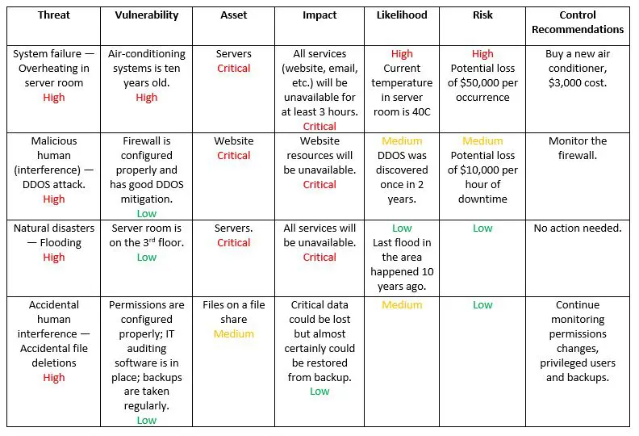
https://blog.netwrix.com/2018/01/16/how-to-perform-it-risk-assessment/

Slide 31
Business Continuity Plan

Slide 32
BUSINESS CONTINUITY PLAN
A business continuity plan refers to an organization’s system of procedures to restore critical business functions in the event of an unplanned disaster.
These disasters could include natural disasters, cyberattacks, service outages, or other potential threats.
Business continuity planning (BCP) enables organizations to resume business operations with minimal downtime.
Exm : hospital
A disaster hits and electricity not available 2 days and only one back up system
Which department and unit

Slide 33
BUSINESS CONTINUITY PLAN
In emergency situations like pandemic outbreaks, power failures, riots, strikes, infrastructure issues, it is important that your business does not stop functioning.
Earlier most companies would document business continuity plans only if their clients asked for it and would focus mainly on IT recovery.
But scenarios have changed now. Corporations of all sized have now realized the importance of keeping their business functioning at all time and hence they are working towards a well defined business continuity management framework.
A Business Continuity Plan (BCP) is of prime importance to your business to ensure minimum disruption and smooth functioning of your operations.

Slide 34
BUSINESS CONTINUITY PLAN
BCP consists of the critical information an organization needs to continue operating during an unplanned event.
It also states the essential functions of the business, identify which systems and processes must be sustained, and detail how to maintain them.
And ensures that personnel and assets are protected and are able to function quickly in the event of a disaster.
The BCP is generally conceived in advance and involves input from key stakeholders and personnel.

Slide 35
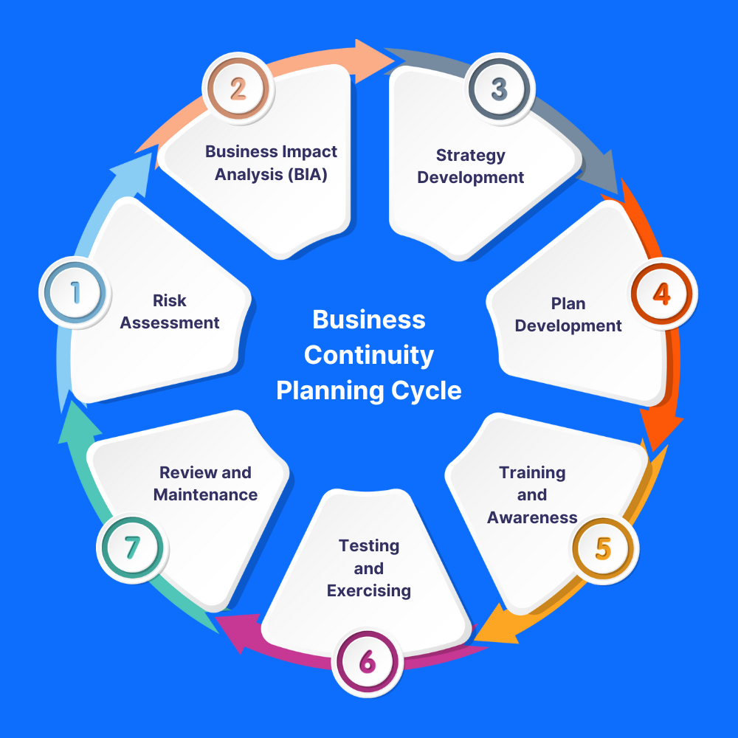
BUSINESS CONTINUITY LIFECYCLE

Slide 36
How does one start with BCM?
Business Impact Analysis (understanding the organization)
The first step is to conduct a Business Impact analysis. This would help you to identity critical business systems and processes and how their outage (downtime) could affect your business. You cannot have plan in place for all the processes without considering financial investments needed to have those in place. CEO’s inputs and client BC requirements also serve as input for impact analysis.

Slide 37
How does one start with BCM?
Defining the plan (Determining BCM strategy)
The next step is to identify the situations that could lead to disruption of the identified critical processes.
The situations could be categorized as: Natural and environmental: – Earthquakes, floods, hurricanes etc.
Human related: – Strikes, terrorist attacks, pandemic situation, thefts etc.
IT related: – critical systems failure, virus attacks etc.
Others: – Business Competition, power failure, Client BC contractual requirements
After the situations have been identified one needs to identify different threats, threat severity (how serious will be the impact on business if threat materializes) and their probability of occurrence (likelihood of threat materialization). Based on threat severity and occurrence levels critical risks are identified.

Slide 38
Implementing the plan (Developing and implementing BCP response)
The identified risks and additional client specific BCP requirements serve as inputs to the creation of BCPs.
BCPs should focus on mitigation plan for the identified risks. BCP should be comprehensive, detailing roles and responsibilities of all the response teams. Proper budget needs to be allocated. Once the plan is documented the plan should be implemented.
The different implementation as per BCP could include having redundant infrastructure, signing up Service Level Agreements (SLAs) with service providers, having backup power supply, sending backup tapes to offshore sites, and training people in cross skills, having proper medicines or masks for addressing pandemic situations.
BCP should also have proper plans in place to resume business as usual. Business resumption is a critical and very important aspect of business continuity framework.

Slide 39
Testing and improving plan (Exercising, maintaining and reviewing)
Once the plans are documented and implemented the plans should be regularly tested. The tests could be scheduled or as and when the need arises. One can simulate different tests like moving people to other locations, having primary infrastructure down, testing UPS and diesel generator capacity, evacuation drills, having senior management backups to take decisions, transport arrangements etc.
The tests will help you identify areas which need improvement in the BCP. The gaps between the expected and actual results need to be compared. The test results needs to be published to senior management. The plan needs to be reviewed regularly to update latest threats and have mitigations for the critical ones which will result in continuous lifecycle.
One can schedule internal audits or apply for BS22301 certification to ensure proper compliance to BCP requirements.

Slide 40
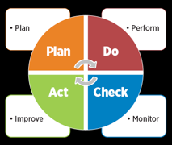
BUSINESS CONTINUITY LIFECYCLE
After the harmful events analysis, adopt a PLAN-DO-CHECK-ACT CYCLE (PDCA) Cycle.

Slide 41
BUSINESS CONTINUITY LIFECYCLE
Business Impact Analysis
Two main terms, which are used : Recovery assumptions
RTO: Recovery Time Objective
A standard definition of RTO is the duration of time in which a business process must be restored after a disaster in order to avoid unacceptable consequences associated with a break in business continuity.
RPO: Recovery Point Objective
RPO is often defined as the maximum targeted period in which data might be lost from a disaster.
Like RTO, this can vary by business as well as vary by the business system within a company. How much data can be ‘lost’? Again most people will say ‘Zero Data Loss’ and in many systems, this can be achieved, but at a certain cost.

Slide 42
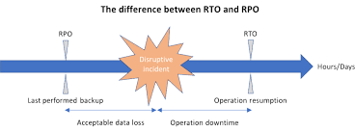
Difference between RTO and RPO

Slide 43
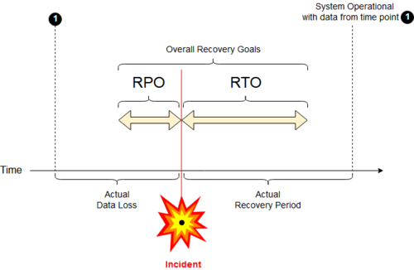
Difference between RTO and RPO

Slide 44
INCIDENT MANAGEMENT

Slide 45
INCIDENT MANAGEMENT
An Incident is defined as an event that causes disruption to or a reduction in the quality of a service which requires an emergency response.
Incident management is the process used by DevOps and IT Operations teams to respond to an unplanned event or service interruption and restore the service to its operational state.
An incident is resolved when the affected service resumes functioning in its intended state.
This includes only those tasks required to mitigate impact and restore functionality.

Slide 46
INCIDENT MANAGEMENT
Types of Incidents:
Based on Priorities, Incidents can be classified as:
Low Priority Incidents
Medium Priority Incidents
High Priority Incidents
Based on Assets, Incidents can be classified as:
Software Incidents
Hardware Incidents
Security Incidents

Slide 47
INCIDENT MANAGEMENT
The Incident Management Process Workflow:
Incident Identification & Logging: Incidents are identified through user reports, solution analyses, or manual identification. Once identified, the incident is logged by the user.
Incident Categorization: Categorization is important to determining how incidents should be handled and for prioritizing response resources.
Incident prioritization: The priority of an incident can be determined as a function of its impact and urgency using a priority matrix. The urgency of an incident indicates the time within which the incident should be resolved

Slide 48
INCIDENT MANAGEMENT
Incident Investigation and Diagnosis: Once incident tasks are assigned, staff can begin investigating the type, cause, and possible solutions for an incident. After an incident is diagnosed, you can determine the appropriate remediation steps.
Incident Escalation :Escalation is based on the categorization assigned to an incident and who is responsible for response procedures. If incidents can be automatically managed, escalation can occur transparently.
Incident Resolution & Closure: Resolution and recovery involve eliminating threats or root causes of issues and restoring systems to full functioning. Closing incidents typically involves finalizing documentation and evaluating the steps taken during response.

Slide 49
INCIDENT MANAGEMENT
The roles & responsibilities in Incident Management are:
Level I support – Filters Help Desk calls and provides basic support and troubleshooting, such as password resets, printer configurations, break/fix instructions. It involves technical Staff.
Level II Support- Level 2 generally handles break/fix, configuration issues, troubleshooting, software installations, hardware repair. It involves specialized trained staff.
Level III Support- It involves major incidents. Besides always having the ability to deploy solutions to new problems, a Level 3 tech usually has the most expertise in a company and is the go-to person for solving difficult issues.

Slide 50
INCIDENT MANAGEMENT
Incident Manager- He manages the process to restore normal service operation as quickly as possible to minimize the impact to business operations.
Responsibilities:
Responsible for planning and coordinating all the activities required to perform, monitor, and report on the process
Responsible for communicating with the Incident Process Owner
Point of contact for all Major Incidents
Responsible for the effective implementation of the process "Incident Management" and carries out the respective reporting procedure.
Represent the first stage of escalation for Incidents
Monitor the workload per Tier 1 Analyst etc.

Slide 51
INCIDENT MANAGEMENT
INCIDENT MANAGEMENT TOOLS:
Monitoring Tools- Monitoring tools give your team constant insight into the health of the infrastructure. Modern monitoring tools also proactively trigger alerts during unexpected activity.
Root Cause Analysis (RCA) Tools- Root cause analysis tools use a systematic process for finding and identifying the root cause of a problem or event. RCA tools starts with figuring out how, where, and why the issue appeared. Then it goes further: RCA strives to respond to that answer—in order to prevent it from happening again.

Slide 52
INCIDENT MANAGEMENT
Incident Response Tools- The tools help to automatically and quickly monitor, identify, and resolve a wide range of security issues, thus streamlining the processes and eliminating the need to perform most repetitive tasks manually. Most of the modern tools can provide multiple capabilities, including automatically detecting and blocking threats and, at the same time, alerting the relevant security teams to investigate the issue further.
Service Desk Tools- these tools simply create incident logs.

Slide 53
LEGAL SYSTEM & CYBERCRIME

Slide 54
LEGAL SYSTEM & CYBERCRIME
Cybercrime is the use of a computer as an instrument to further illegal ends, such as committing fraud, trafficking in child pornography and intellectual property, stealing identities, or violating privacy.
Cybercrime, especially involving the Internet, represents an extension of existing criminal behaviour alongside some novel illegal activities.
A primary effect of cybercrime is financial; secondary effect is affecting Individual private information

Slide 55
LEGAL SYSTEM & CYBERCRIME
TYPES OF CYBERCRIME: Depending on the ways in which computers are used for crimes, Cybercrimes are divided further as:
Cybercrimes wherein Computer is the target
Virus Dissemination
DDOS attack
Potentially Unwanted Programs
Ransomware Attack

Slide 56
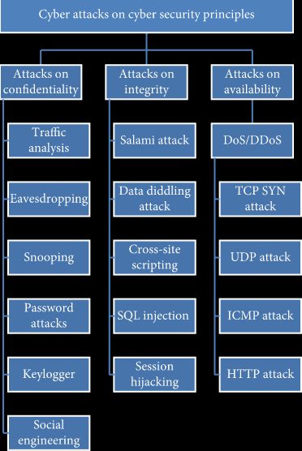

Slide 57
LEGAL SYSTEM & CYBERCRIME
Cybercrimes where Computer is a tool
Botnet
Identity Theft
Cyberstalking
Social Engineering
Phishing
Illegal Content
Online Scams
Online Child Abuse

Slide 58
LEGAL ENFORCEMENT CHALLENGES
The following challenges can be encountered in legal enforcements of Cyber crimes:
Jurisdiction
Poor Knowledge about Prosecution
Non reporting of Cybercrimes
Difficulty in Gathering Legal Digital Evidences

Slide 59
ETHICAL ISSUES IN SECURITY MANAGEMENT
AREA | ETHICAL ISSUES
Technology Intrusion | Privacy internal/external to firm Computer Surveillance Employee Monitoring Hacking
Personnel Issues | Employee Interruption Ergonomics & Human Factors Training to avoid Job obsolescence
Legal & Social Responsibilities | Misuse, fraud, Abuse Accuracy and timeliness of data Monopoly of Data
Ownership Issues | Proprietary Rights Conflicts of Interest Software Copyrights Personal benefits from company assets Theft of Data, Software, Hardware

Slide 60
ETHICAL ISSUES IN SECURITY MANAGEMENT
The ACM Code of Ethics and Professional Conduct
Strive to achieve the highest quality, effectiveness, and dignity in both the process and products of professional work.
Acquire and maintain professional competence.
Know and respect existing laws pertaining to professional work.
Accept and provide appropriate professional review.
Give comprehensive and thorough evaluations of computer systems and their impacts, including analysis and possible risks.
Honor contracts, agreements, and assigned responsibilities.
Improve public understanding of computing and its consequences.
Access computing and communication resources only when authorized to do so.

Slide 61
ETHICAL ISSUES IN SECURITY MANAGEMENT
The IEEE Code of Ethics and Professional Conduct:
To accept responsibility in making decisions consistent with the safety, health and welfare of the public, and to disclose promptly factors that might endanger the public or the environment;
To avoid real or perceived conflicts of interest whenever possible, and to disclose them to affected parties when they do exist;
To be honest and realistic in stating claims or estimates based on available data;
To reject bribery in all its forms;
To improve the understanding of technology, its appropriate application, and potential consequences;

Slide 62
ETHICAL ISSUES IN SECURITY MANAGEMENT
To maintain and improve our technical competence and to undertake technological tasks for others only if qualified by training or experience, or after full disclosure of pertinent limitations;
To seek, accept, and offer honest criticism of technical work, to acknowledge and correct errors, and to credit properly the contributions of others;
To treat fairly all persons regardless of such factors as race, religion, gender, disability, age, or national origin;
To avoid injuring others, their property, reputation, or employment by false or malicious action;
To assist colleagues and co-workers in their professional development and to support them in following this code of ethics.

Slide 63
THANK YOU

